Slide 1



Human Resources Analytics
Done by:
Mariam Mohmmed
Reem A.karim
Fatema Yusuf
Fatima Ali Saleh
Fatima Sharaf Sayed Ali

Slide 2
Agenda
01
02
03
04
05
Introduction
Problem Statement
Challenges
Analysis Result
Conclusion

Slide 3
Introduction
01

Slide 4

Human Resources (HR) is the backbone of any organization, responsible for managing the most valuable asset: its people. HR encompasses recruitment, onboarding, training, and development, ensuring employees are well-equipped and motivated. It also handles employee relations, benefits, and compliance with labor laws. HR plays a crucial role in achieving organizational goals by fostering a positive work environment. Ultimately, HR aims to create a productive and engaged workforce that drives company success.

Slide 5
Problem Statemaent
02

Slide 6
Modern companies deal with extensive data, including crucial human resource information. HR departments face challenges in analyzing this data effectively to improve decision-making and presenting insights in a clear, understandable manner. Visual aids like hierarchy charts are essential for simplifying complex organizational structures, but due to limited data, creating these charts was not feasible.

Slide 7
Challenges
03

Slide 8
We encountered a few challenges throughout this project, primarily due to time constraints and limited resources for a complex topic like human resources management. As a result, we were unable to create essential visual aids such as the hierarchy chart, which would have significantly improved project clarity.

Slide 9
04
Analysis Result

Slide 10
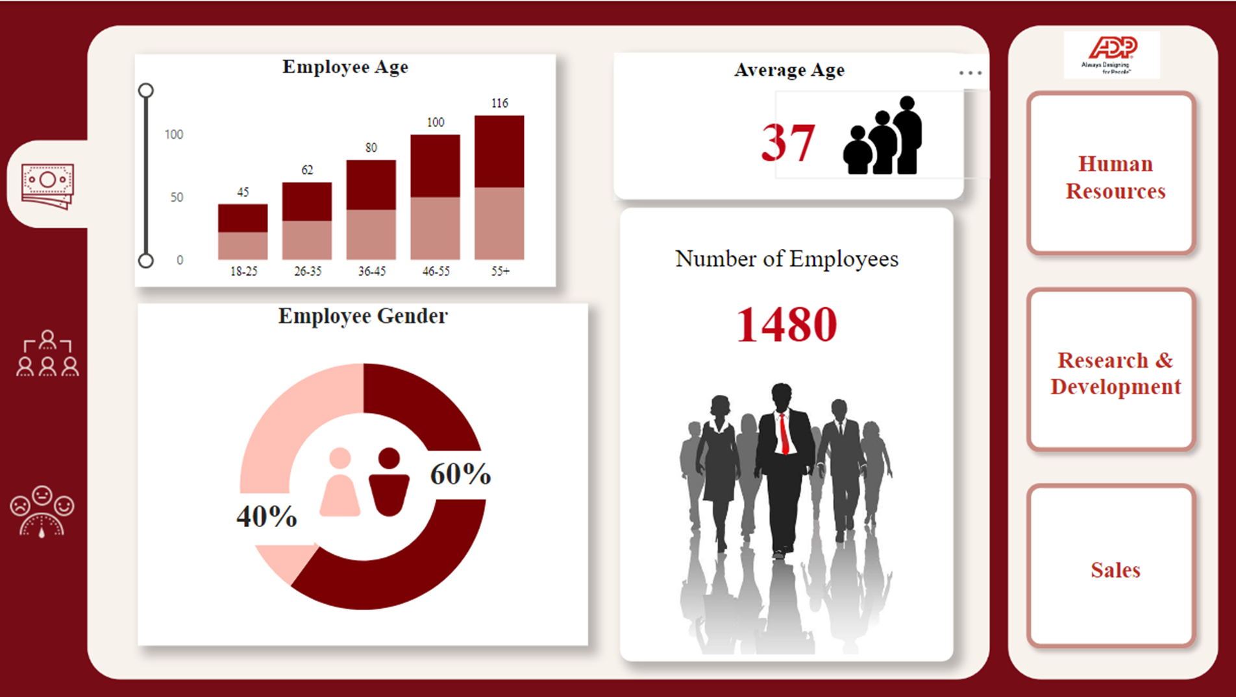
Visualizations Used:
Pie Chart.
Donut Chart.
Cards.
Slicer.
Bar Chart.
Guage Chart.
Stacked Column Chart.
Table.
Funnel Chart.

Slide 12
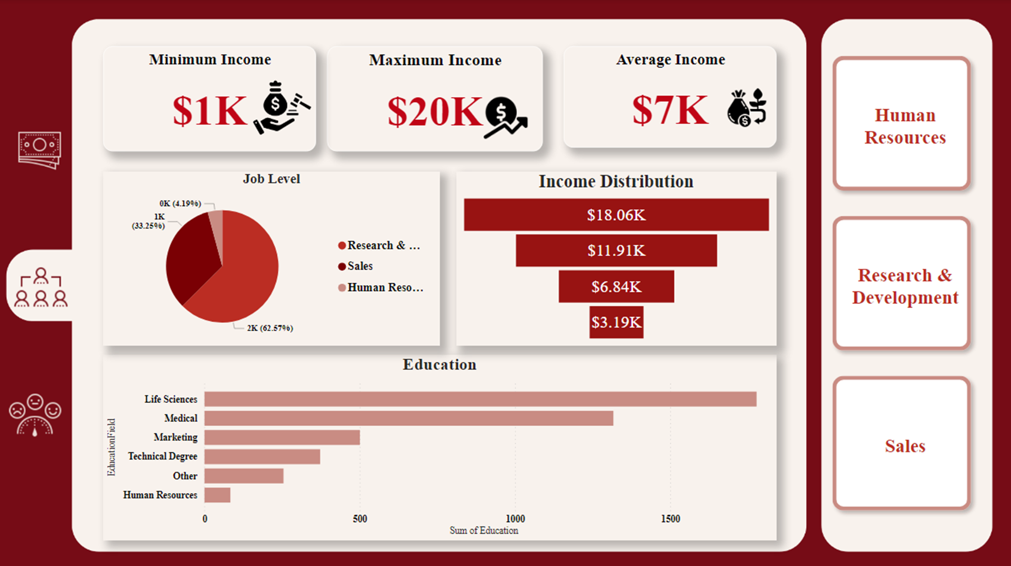

Slide 13
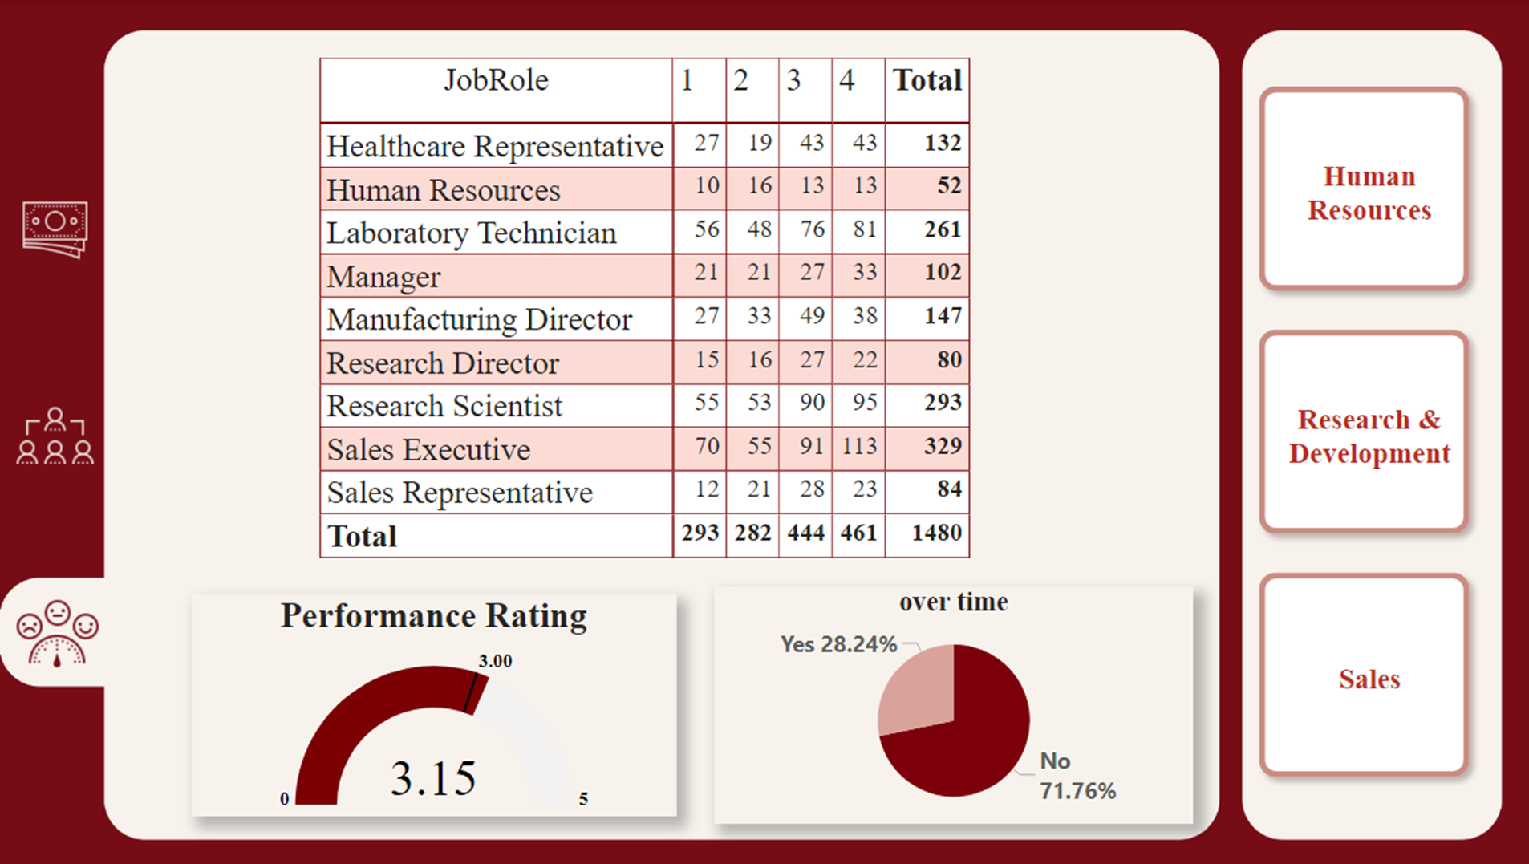

Slide 14
Conclusion
05

Slide 15
Human Resources is the backbone of any organization, ensuring the well-being and growth of its employees. By fostering a supportive and inclusive workplace, HR drives employee engagement and productivity. Continuous development and fair evaluation processes are crucial for sustaining a motivated workforce. Ultimately, effective HR practices lead to organizational success and a positive company culture.

Slide 16
Thanks!

